Slide 1
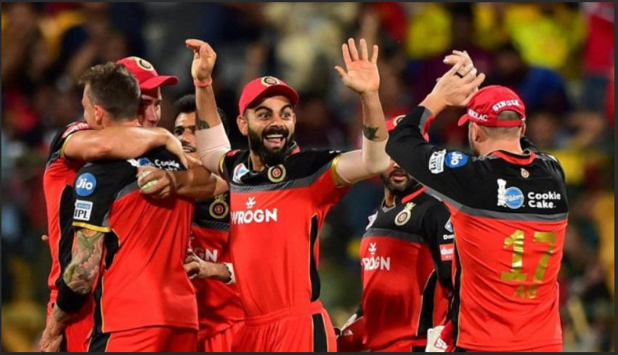
EDA on IPL Players Contribution to the teams
Presented by Harsharan Singh Kohli
For Term 1 & 2 GCD

Slide 2
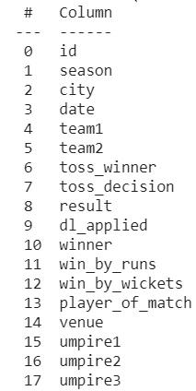
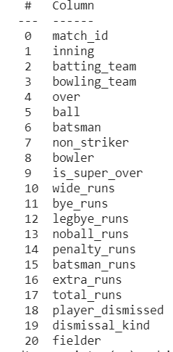
Introduction
2 files were used named Matches and Deliveries with the below mentioned heads

Slide 3
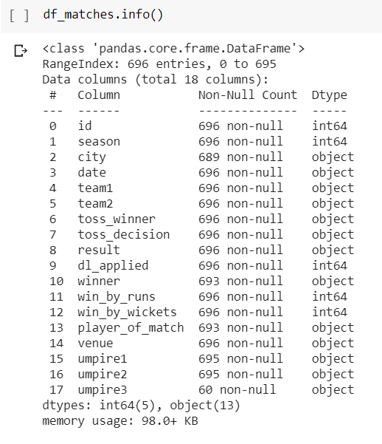
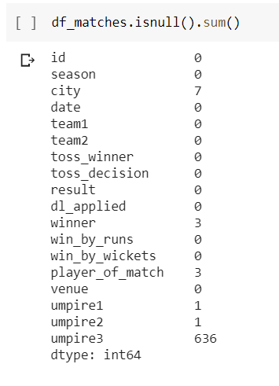
Missing Data
City -7-can be ignored as the match was played and had a result
Winner & player of match 3-Match ended in ‘No Result ‘ state
Umpire1 & Umpire2 1-Ignore the missing data
Umpire3 636-the third umpire was not needed

Slide 4
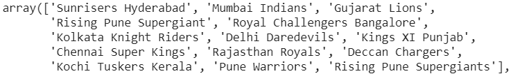
Total of 11 seasons were played & 12 Teams participated
Matches played during
2008,2009,2010,2011,2012,2013,2014,2015,2016,2017 & 2018
Total Matches played and with winners were 693
For 3 matches there were no winners
488 Batsmen & 378 bowlers played in IPL
Matches with 3rd Umpire 60 and matches with no 3rd umpire 636

Slide 5
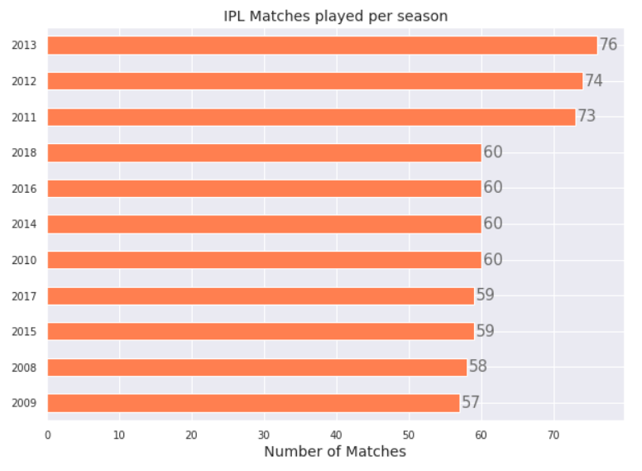
Matches Played Per Season
Most Matches were Played in 2013 (76) followed by 2012 (74) & 2011 (73)

Slide 6
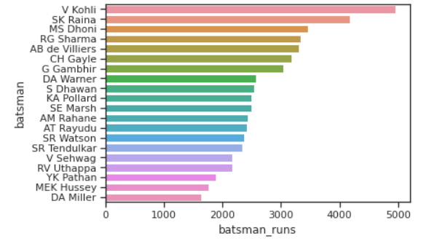
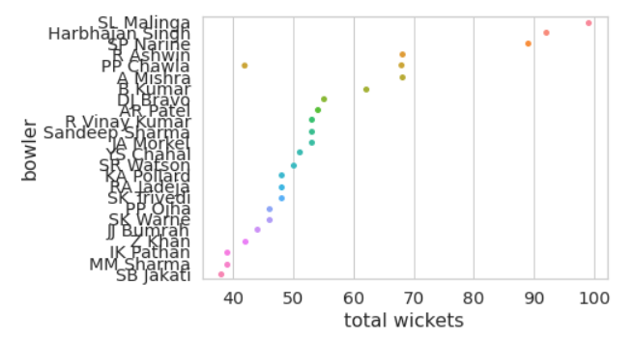
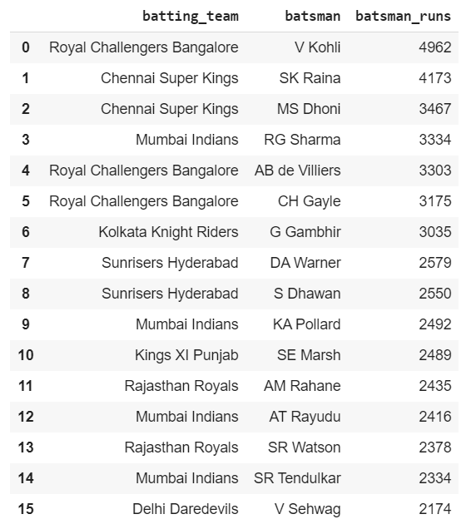
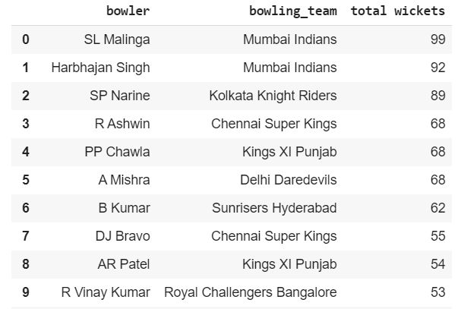
Top Batsmen & Bowlers across seasons

Slide 7
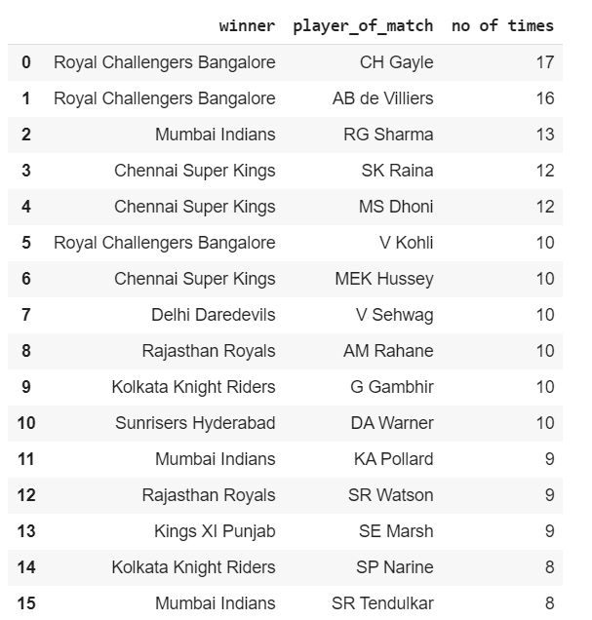
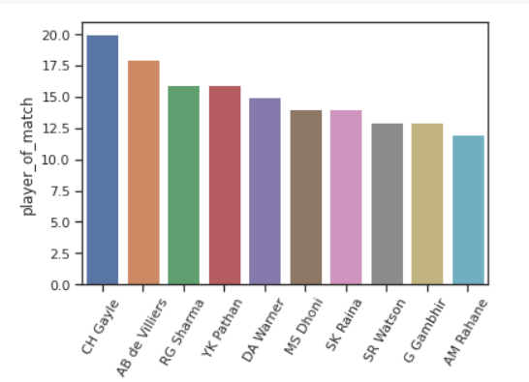
Player of the Match Titles

Slide 8
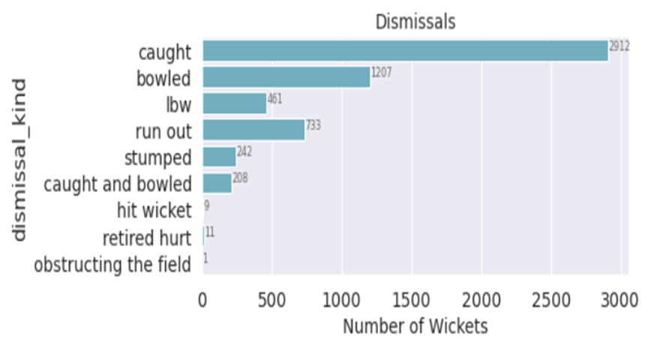
Dismissal Types

Slide 9
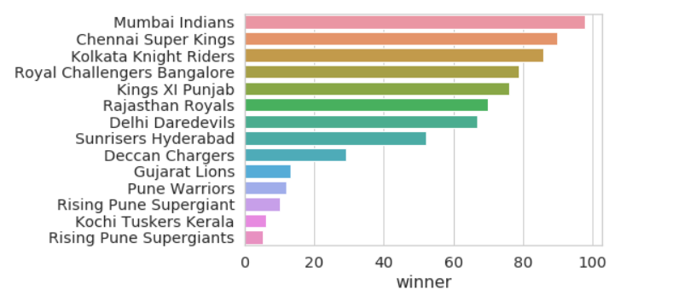
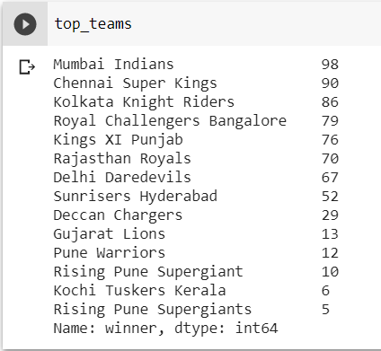
Top Teams-Matches Won
Top Team which won most matches across all seasons is Mumbai Indians followed by Chennai Super Kings and Kolkata Knight Riders

Slide 10
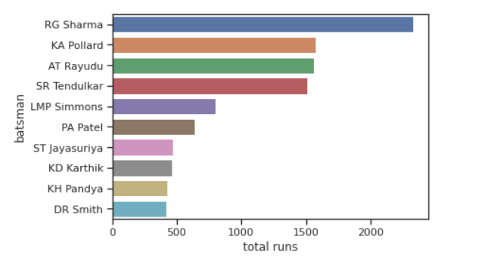
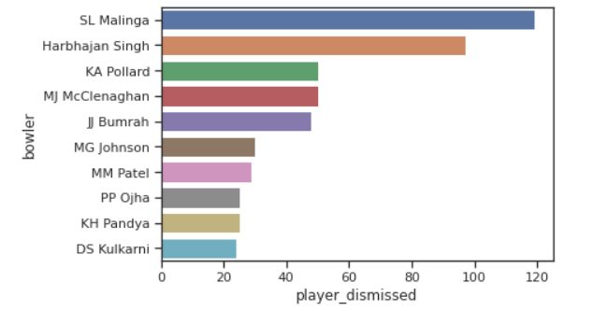
Team (MI) –Top Batsmen & Bowler
SL Malinga,Harbhajan Singh & KA Pollard are the top bowlers of the team MI
RG Sharma,KA Pollard & AT Rayudu are the top batsmen in team MI

Slide 11
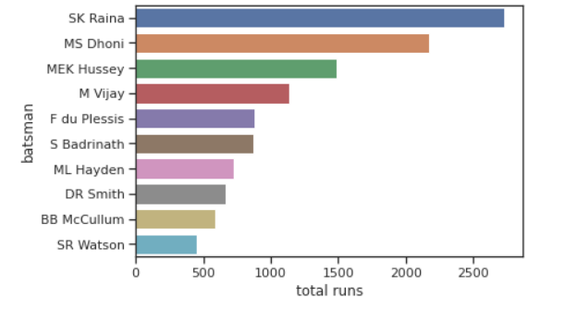
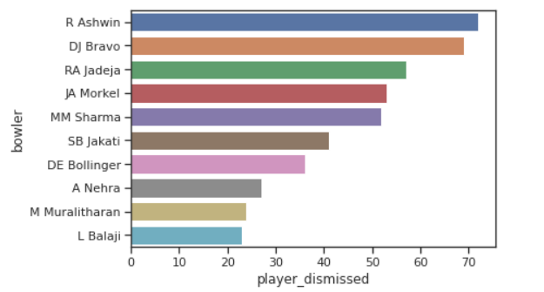
Team (CSK) –Top Batsmen & Bowler
R Ashwin,DJ Bravo & RA Jadeja are the top bowlers of the team CSK
SL Malinga,Harbhajan Singh & KA Pollard are the top bowlers of the team MI
SK Raina,MS Dhoni & MEK Hussey are the top batsmen in team CSK

Slide 12
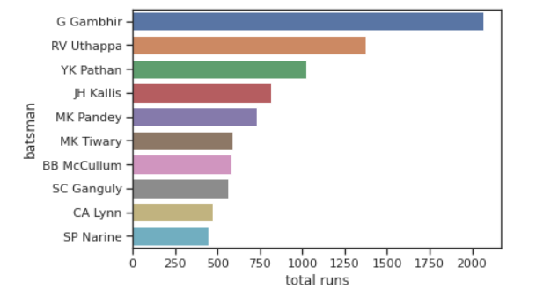
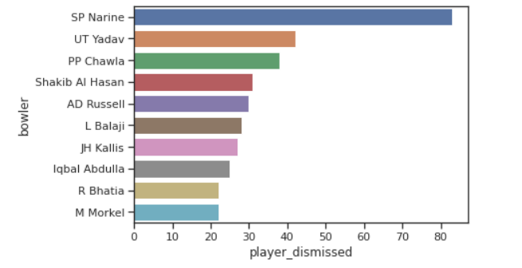
Team (KKR) –Top Batsmen & Bowler
SP Narine,UT Yadav & PP Chawla are the top bowlers of the team KKR
G Gambhir,RV Uthappa & YK Pathan are the top batsmen in team KKR

Slide 13
Thank You

